Slide 1
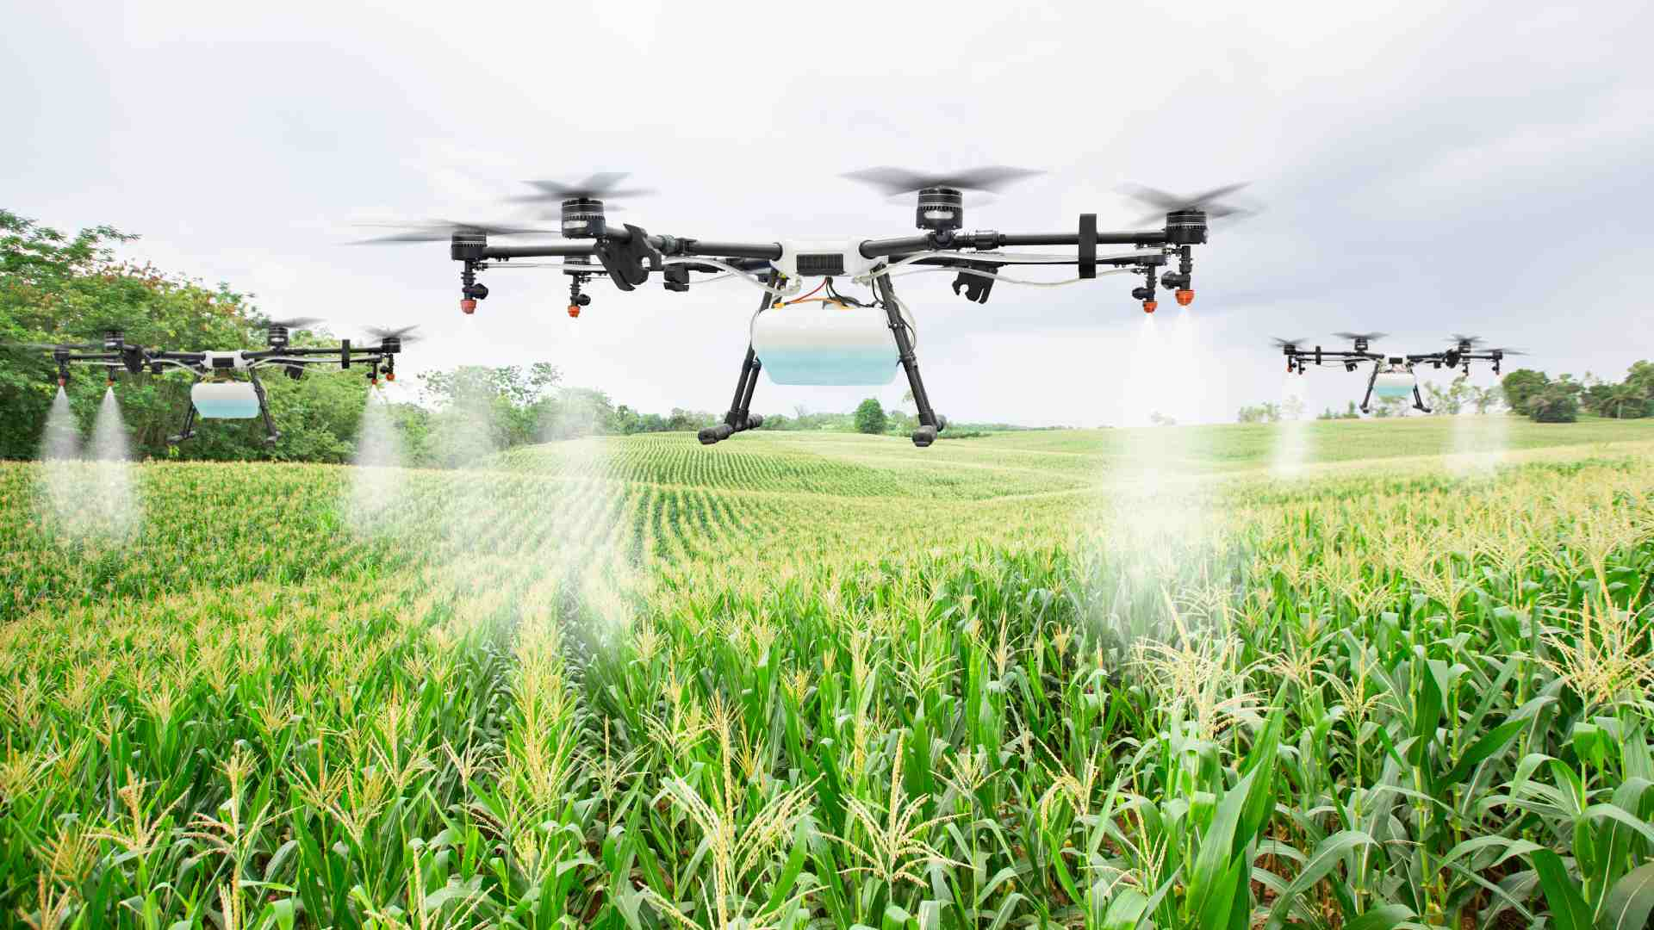
KISAAN SUVIDHA
Group Members:
Utsav Mandal 30
Prasad Gade 14
Prashant Gupta 17
Ravi Rai 42

Slide 2
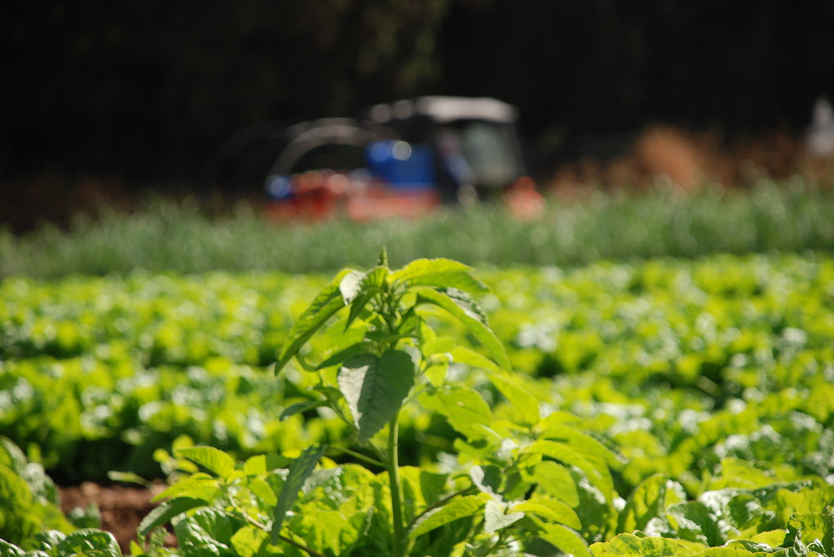
CONTENT
Problem Statement
Introduction to the project
Objectives of the project
Technologies used
System Design
Front End
Implementation
Gantt Chart
Conclusion
References

Slide 3
PROBLEM STATEMENT
“At a given time, farmer equipments, lands are idle during non-seasons. A platform that allows farmers to rent farming equipment, land for less during the off-season as well as a platform that spread awareness about the recent government schemes as well . A simple aggregation platform can function as booking equipment and renting land will help farmers make additional income.”

Slide 4
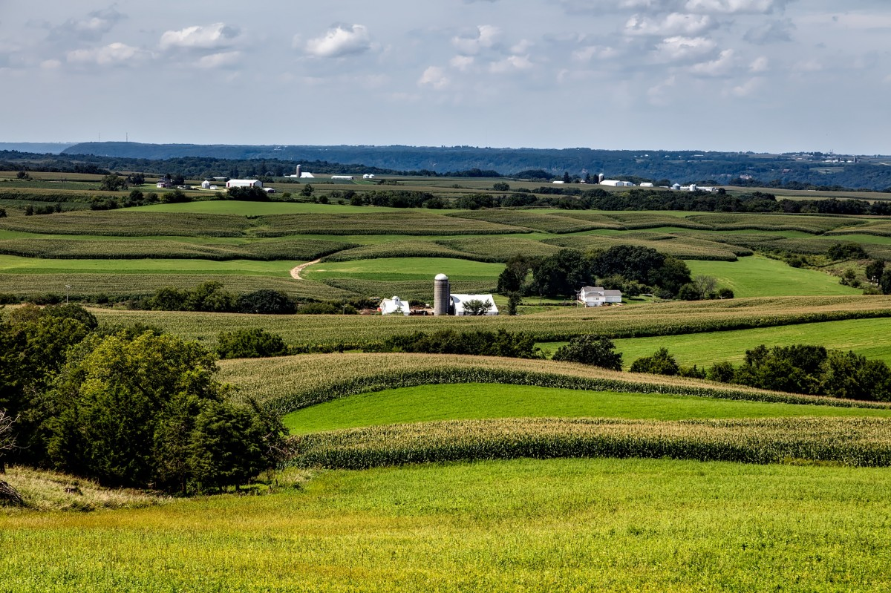
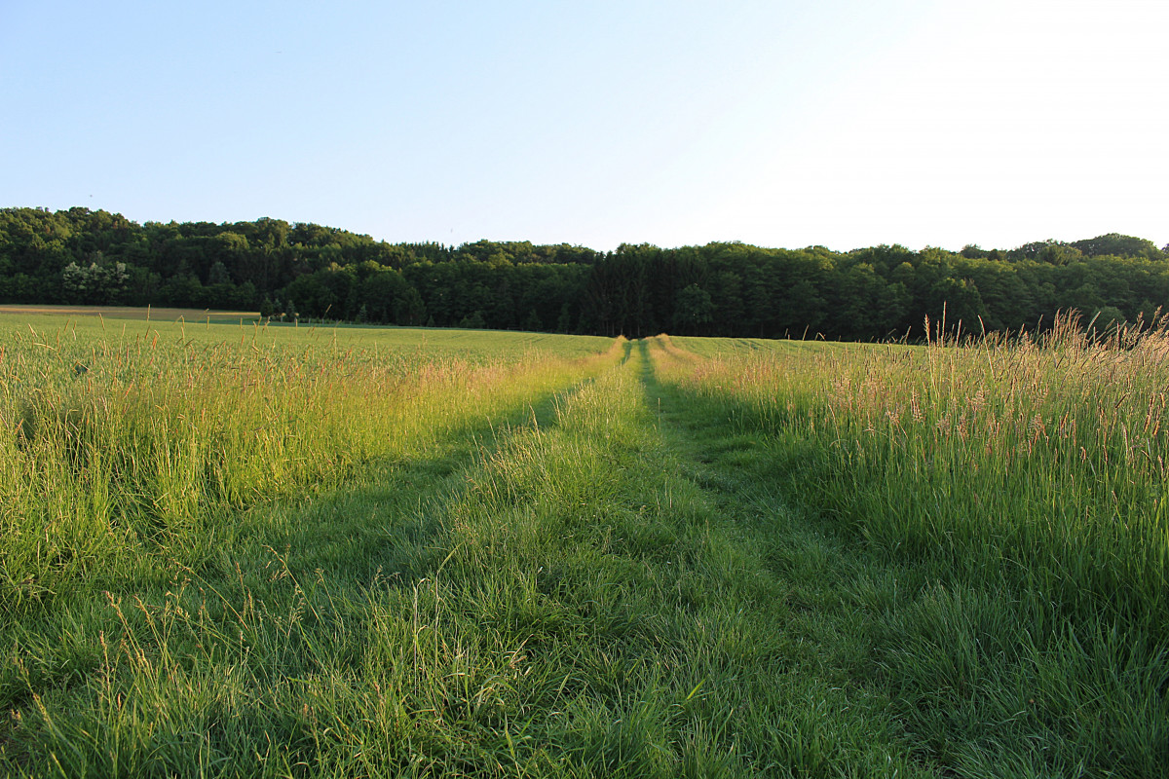
INTRODUCTION TO PROJECT
KISAAN SUVIDHA
- A one stop Web app. Solution for all farmer needs.

Slide 5
OBJECTIVES OF PROJECT
User-friendly web platform.
Raise awareness about available government schemes and subsidies for farmers.
Easy rent modern agricultural equipment.
Easy rent land.
Scalable and Robust platform.
Multilingual Support.

Slide 6







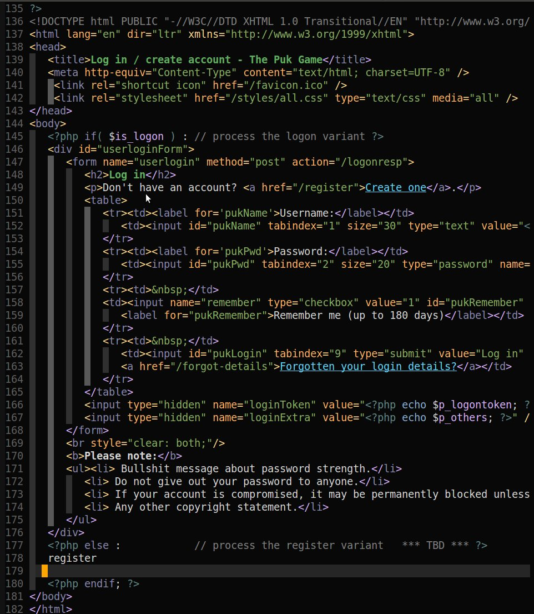
TECHNOLOGIES USED
Frontend:
HTML ,CSS ,ReactJS ,JavaScript ,Bootstrap.
Backend:
NodeJS ( Sequelize ORM )
Database:
MySQL
Framework:
ExpressJS

Slide 7
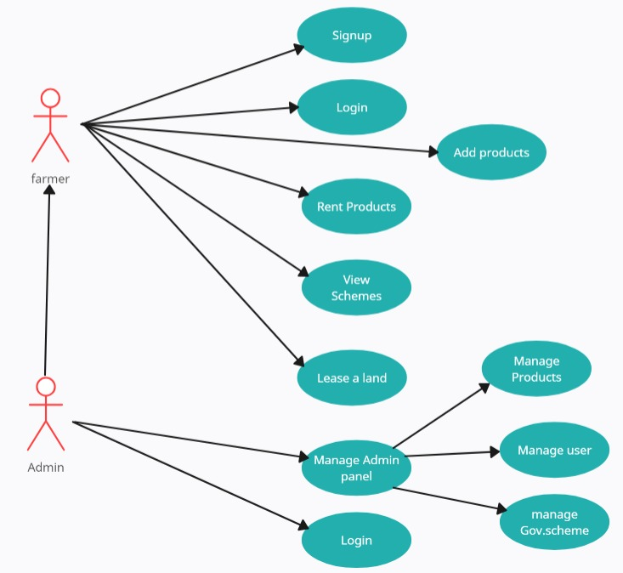
SYSTEM DESIGN
USE CASE DIAGRAM

Slide 8
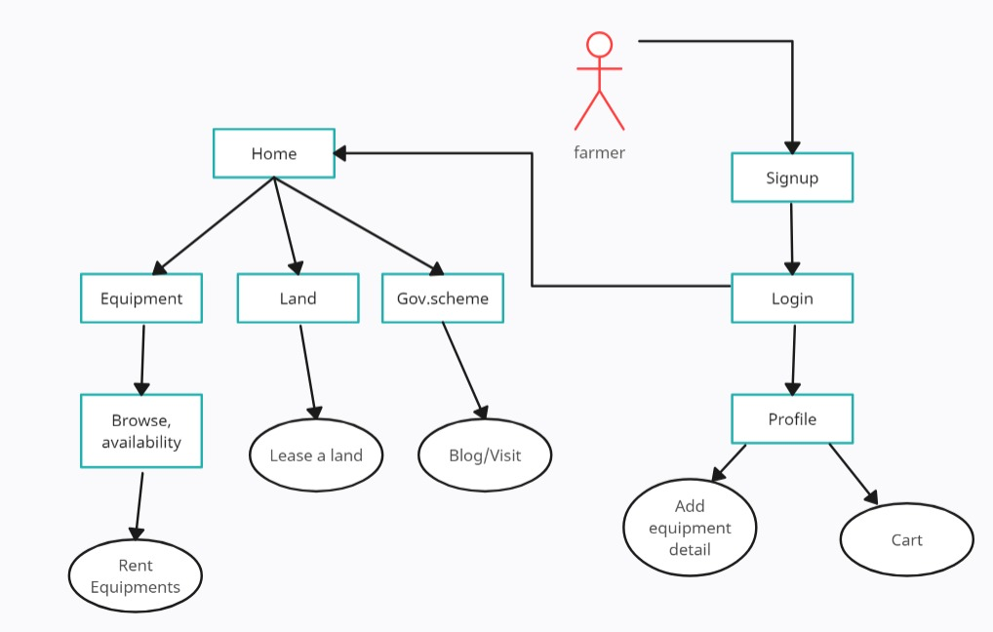
SYSTEM DESIGN
FLOW DIAGRAM

Slide 9
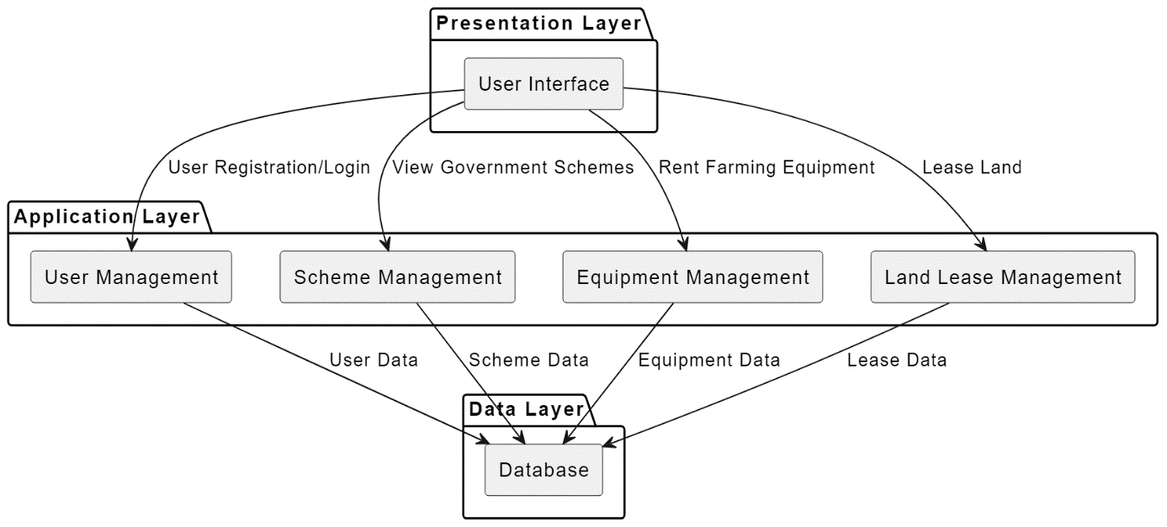
SYSTEM DESIGN
ARCHITECTURE DIAGRAM

Slide 10
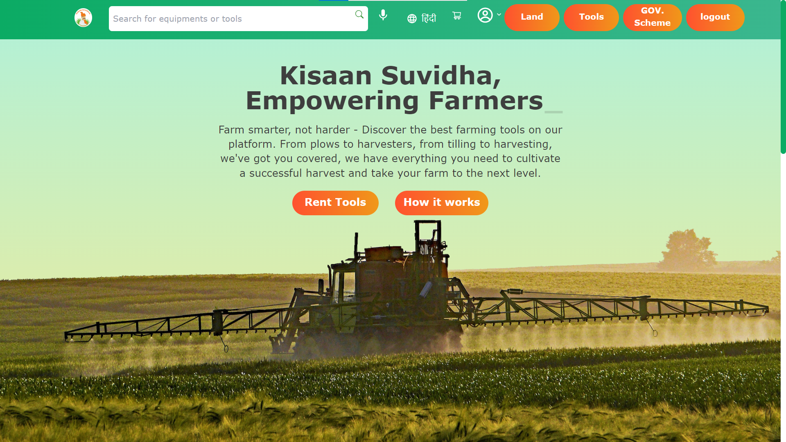
FRONTEND

Slide 11
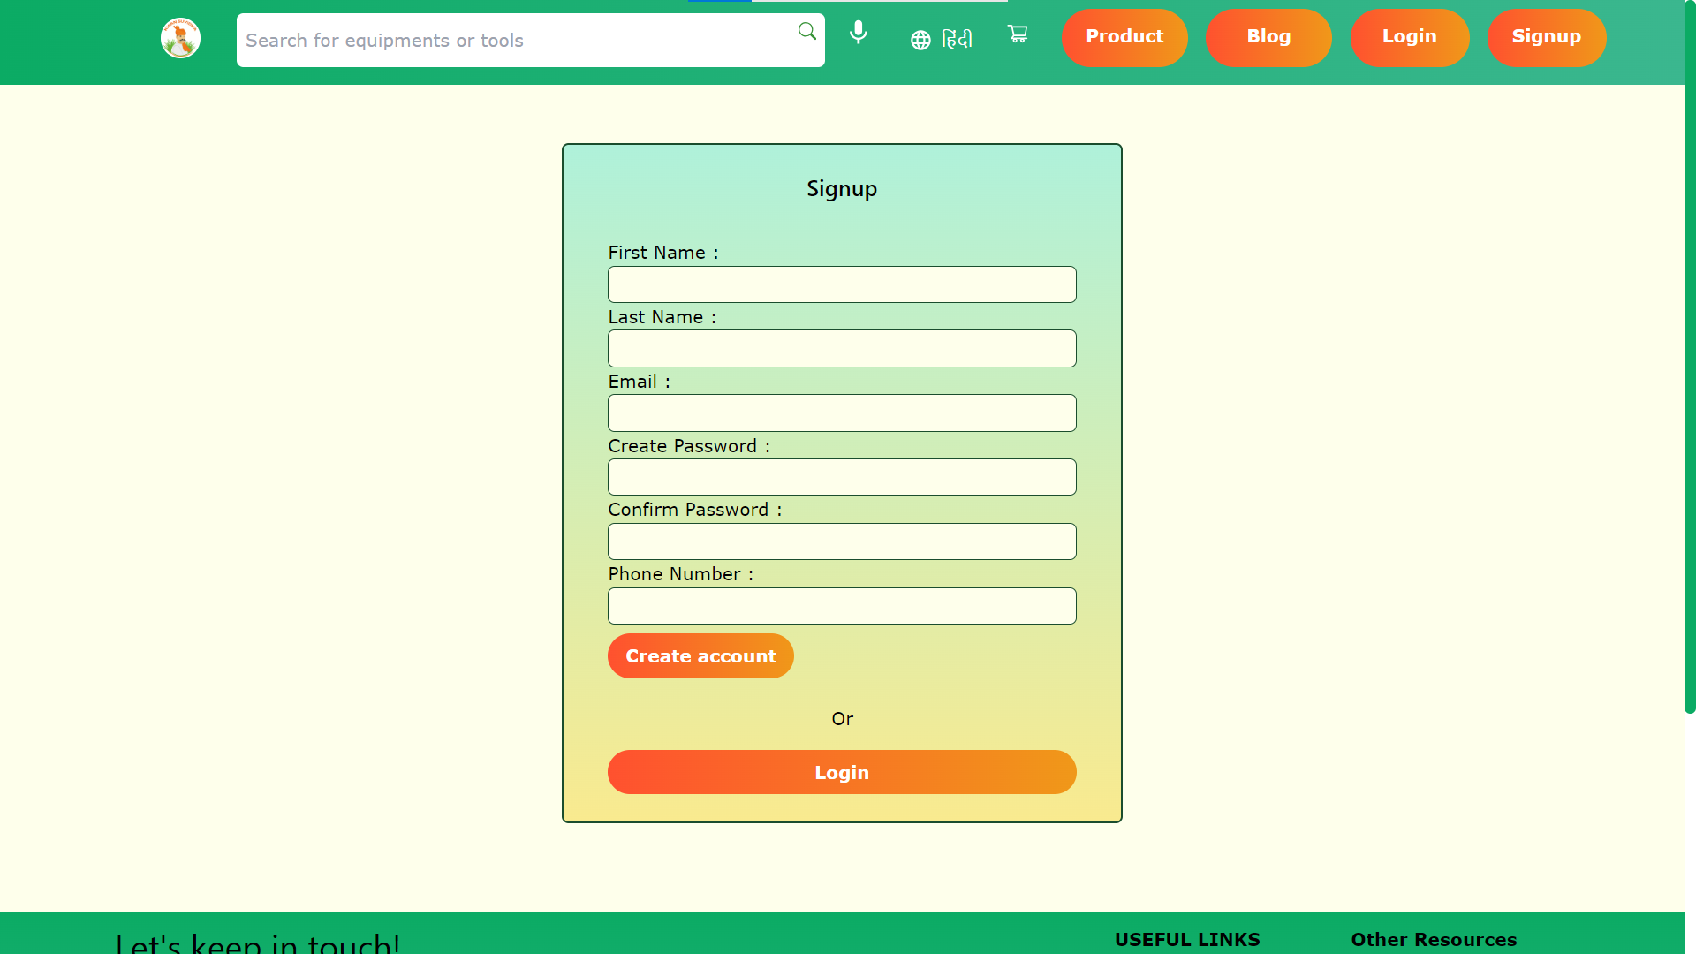
FRONTEND

Slide 12
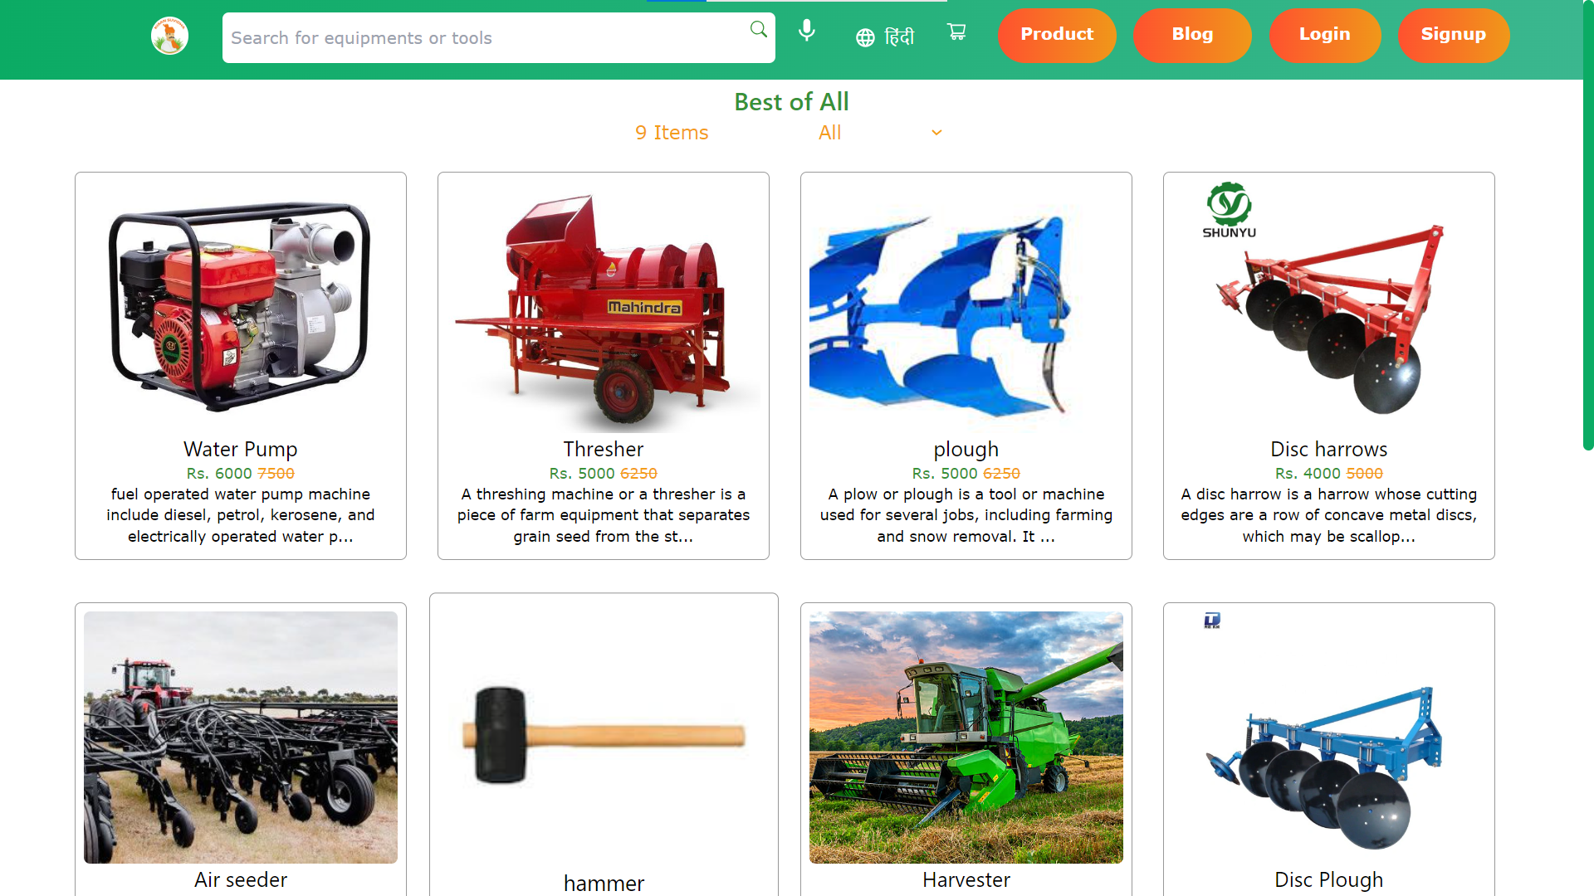
IMPLEMENTATION

Slide 13
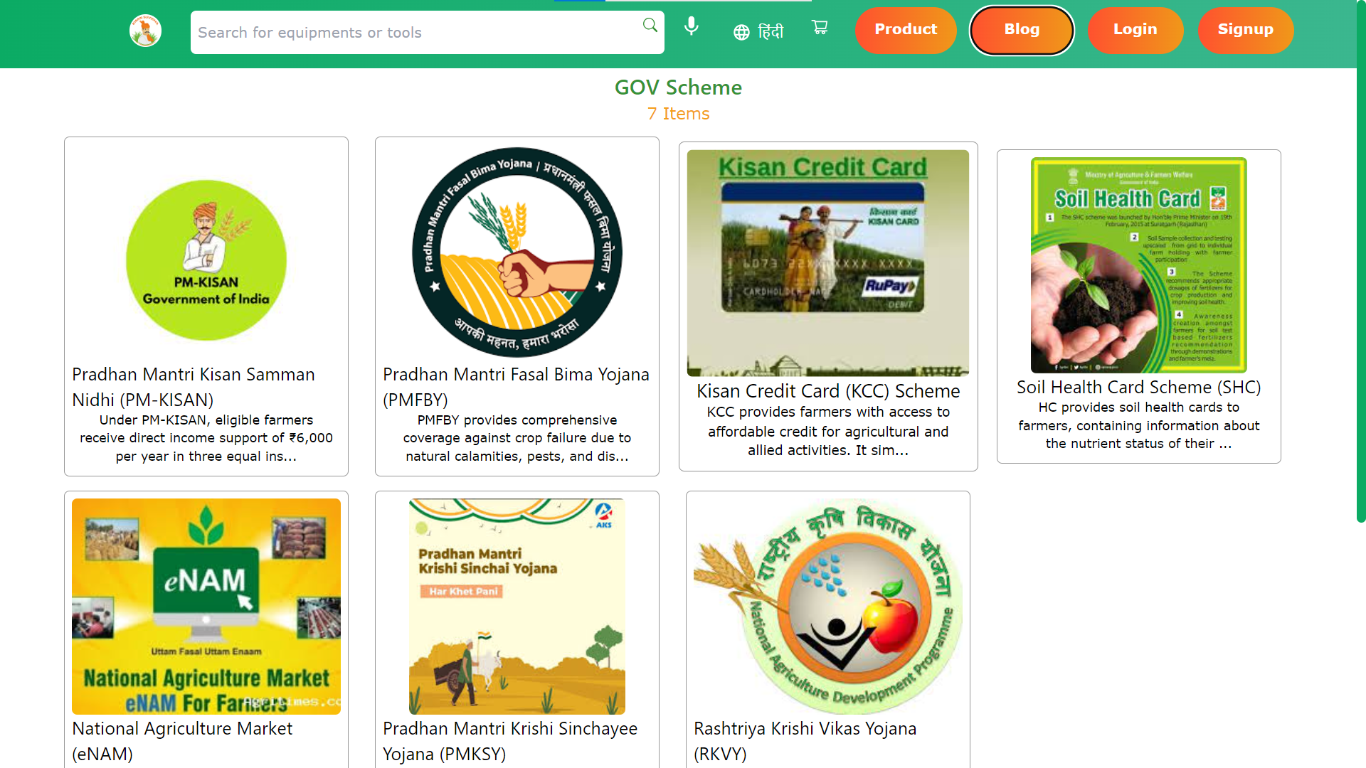
IMPLEMENTATION

Slide 14
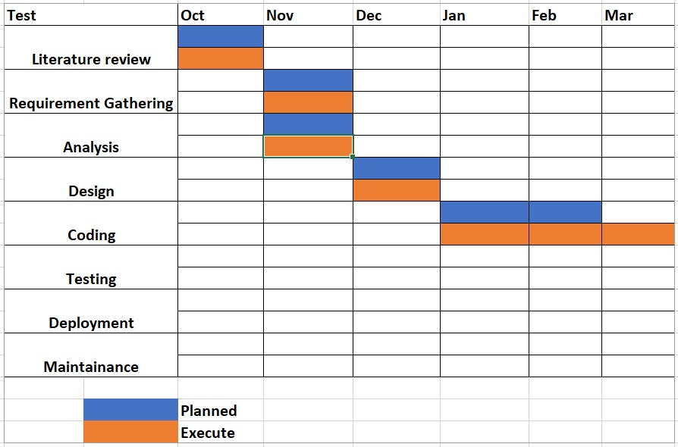
GANTT CHART

Slide 15
CONCLUSION
Our comprehensive Web platform is poised to revolutionize the agricultural landscape by addressing key challenges faced by farmers and landowners. By promoting government schemes and subsidies, facilitating transparent land rental transactions, and providing easy access to modern agricultural equipment, our platform aims to empower the farming community.
The scalability and robustness of our platform ensure its effectiveness in accommodating a large user base, fostering widespread adoption. With a user-friendly interface and a commitment to inclusivity, we offer localization options and multilingual support to cater to diverse user groups, making information and services accessible to everyone.

Slide 16
REFERENCES
FARMING MADE EASY USING MACHINE LEARNING Dr. DVNS Murthy 1 , Ms. S. Sunitha2 , Vol.14 No.02(2023),1044- 1054
Youtube: https://youtu.be/zJcSod-L-Ps?si=Jq7o6XG-A68VQA8B
stackoverflow
Wikipedia
IEEE

Slide 17
THANK YOU!!!!

